Slide 1
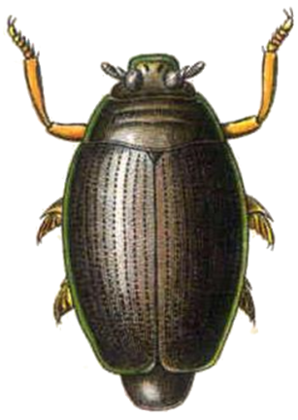
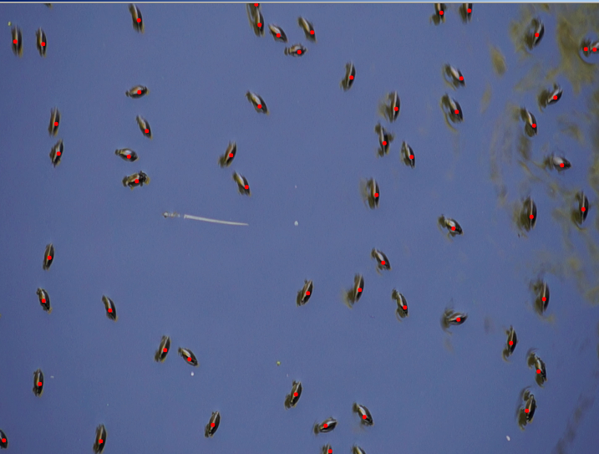
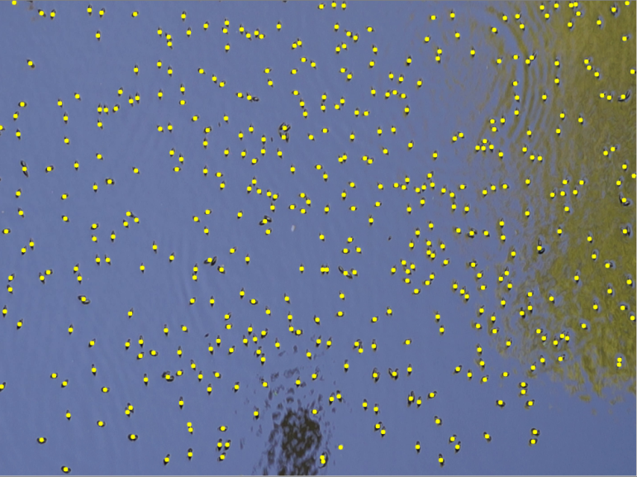
Project Whirligig
Tyler May Jared Haeme
Kyle McCaw Tan Nguyen
Dr. Stonedahl
Object Detection/Tracking
Single Frame/Multi Frame
Computer Vision(Open CV)
Neural Network
Agent Based Modeling

Slide 2
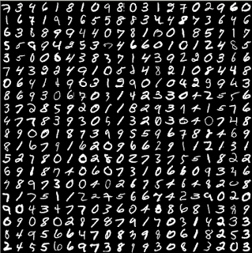
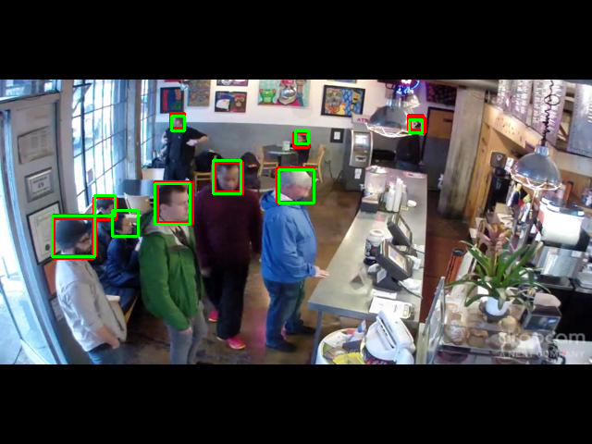
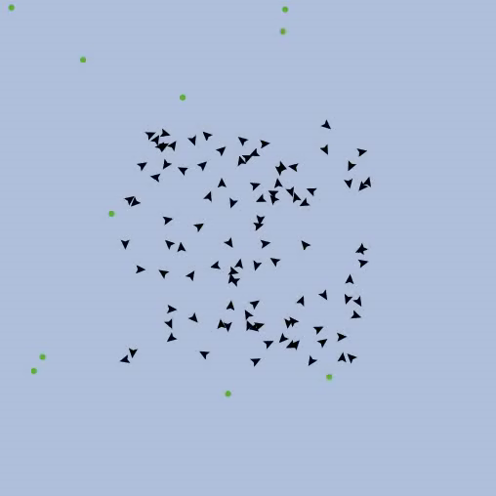
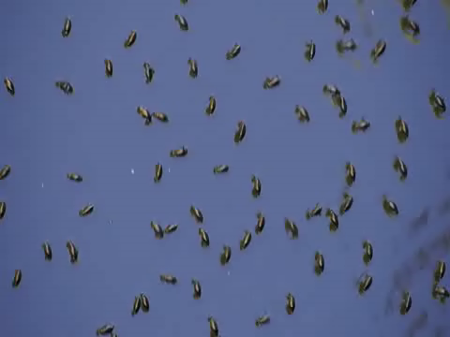
Project Whirligig
Artificial Neural Networks
TensorFlow
TensorBox
Computer Simulation using NetLogo

